Slide 1
Impacts: an analysis of stream health and plant diversity in riparian ecosystems
Kevin Race & Sarah Rizk

Slide 2
Macroinvertebrate i.d.: rock creek
Order | Family | Common Name | Count
Trichoptera | Glossomatidae | Saddle-case makers | 1
Trichoptera | Brachycentridae | Grannom's caddis | 16
Trichoptera | Apataniidae | Early smoky wing sedge | 2
Ephemeroptera | Caenidae | Small squaregill mayfly | 1
Ephemeroptera | Leptophlebiidae | Prong-gilled mayfly | 31
Plecoptera | Perlodidae | Stripetails | 3
Odonata | Libellulidae | Skimmer | 1
Diptera | Tipulidae | Crane fly | 2
– | – | Aquatic worms | 7
– | – | – | 64
Notes:
Richness = 9 Families (we’ll count aquatic worms as a family) present
# Individuals = 64

Slide 3
Macroinvertebrate i.d.: laramie river
Order | Family | Common Name | Count
Trichoptera | Hydropsychidae | Net-spinning caddisfly | 38
Ephemeroptera | Leptophlebiidae | Prong-gilled mayfly | 9
Ephemeroptera | Heptageniidae | Flat-headed mayfly | 2
Ephemeroptera | Caenidae | Small squaregill mayfly | 17
Odonata | Libellulidae | Skimmer | 5
– | – | Aquatic worms | 27
– | – | – | 98
Notes:
Richness = 6 Families
# Individuals = 98

Slide 4
Species accumulation curve: rock creek
Notes:
Look for a flattening out of the curve – indicates that you’ve adequately measured the community makeup of the ecosystem
Rock Creek quasi-flattens out; general trend is present

Slide 5
Species accumulation curve: laramie river
Notes:
Flattening out is obvious among the Laramie River samplings

Slide 6
Vegetation Comparison
Rock Creek vs. Laramie River
Biodiversity will be better preserved in Rock Creek, an alpine environment, rather than Laramie River, an urban environment.
Elevation Changes
Laramie's elevation: 7165 ft.
Rock Creek's elevation: 7280 ft.
Native and Non-native Species
Abundance of non-native species in Laramie River
Urbanization

Slide 7
Urbanization as a cause
Ottawa study shows 40% more non native plant species and 53% greater proportion of introduced species than plants found in agricultural or forest areas
Population
Threats of non-native plants to the area
Anthropogenic factors and biodiversity correlation
Optimist Park

Slide 8
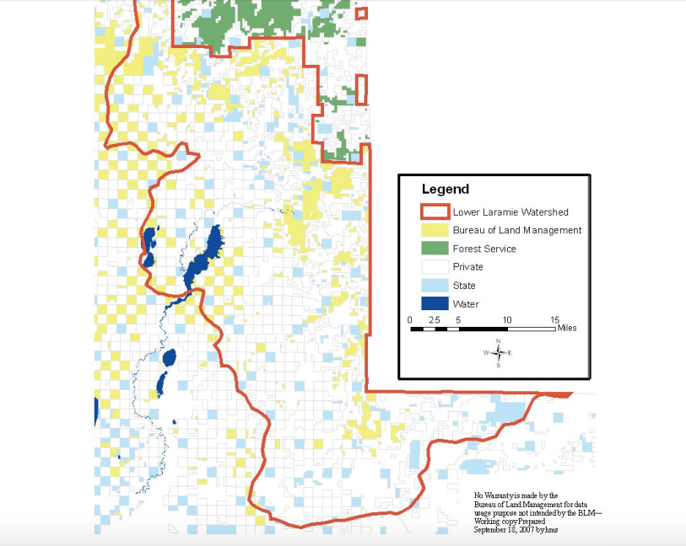
National PARK regulations

Slide 9
Materials and mETHODS
Hula hoop as Daubenmire frame
Surveyed every 15m (15m, 30m, 45m, 60m, and 75m) for a total of 5 transects
Four sites perpendicular to water along every transect every 5-7 m

Slide 10
Materials and methods cont.
3m of rock or sand/mud lined each sites
Averaged 10 random rock sizes and percentage survey
What kind of plant, leaf observations, and other distinguishing features
Collected labeled samples

Slide 11
Results and Data Analysis
Lots of variation and no overlap
Salix indent
Many id's are tentative
Id's classify as same plant, not definitive
It is also important to note that indents or unknowns between the two sites are not the same
For example, salix indent 1 at Rock Creek is not the same salix indent 1 in Laramie River

Slide 12
Laramie River

Slide 13
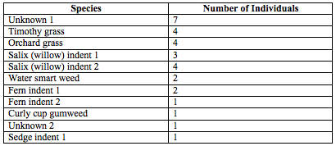
Laramie River
Simpson’s index of .13 and reciprocal of 7.69. There was a total of 11 species sampled.

Slide 14
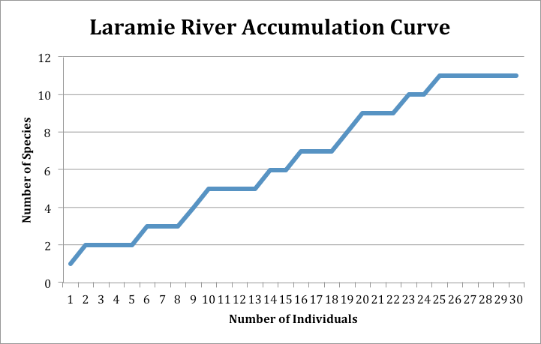
Laramie River

Slide 15
Rock Creek
Simpson’s index of .0715 and reciprocal of 13.99.
There was a total of 19 species present.

Slide 16
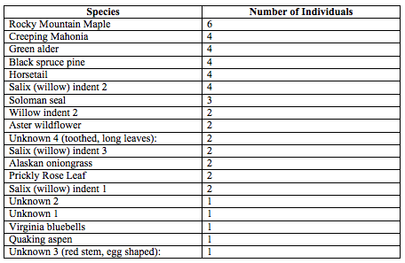
Rock creek

Slide 17
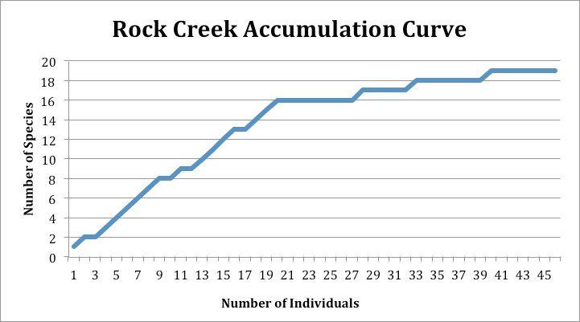
Rock Creek

Slide 18
Vegetation Conclusion
Two sites were not comparable
Urbanization as a major cause
Overall, accept hypothesis
To revise this survey, I would id plants on the spot when possible and create a list of non-native species

Slide 19
References
22:589–599, Landscape Ecol (2007), and Doi 10.1007/s10980-006-9050. Effects of Surrounding Urbanization on Non-native Flora in Small Forest Patches (n.d.): n. pag. Research Gate. Landscape Ecology, Jan. 2007. Web. 27 July 2016.
Murphy, Dennis D. "Challenges to Biological Diversity in Urban Areas." NCBI. NCBI, n.d. Web. 27 July 2016
"Natural Resources Conservation Service." Native, Invasive, and Other Plant-Related Definitions. N.p., n.d. Web. 28 July 2016.
"PCP." PCP. BLM Wyoming Plant Conservation, Sept. 2014. Web. 28 July 2016.
Season, 2006 Field. "Lower Laramie River Watershed Standards and Guidelines Assesments." (n.d.): n. pag. BLM Lower Laramie. Web. 27 July 2016.
M Lower Laramie. Web. 27 July 2016.

