Slide 1
CAN farmers’ markets ameliorate food deserts?
A Study on Income, Obesity, and Food Deserts
Sarah Rizk, Spring 2018

Slide 2
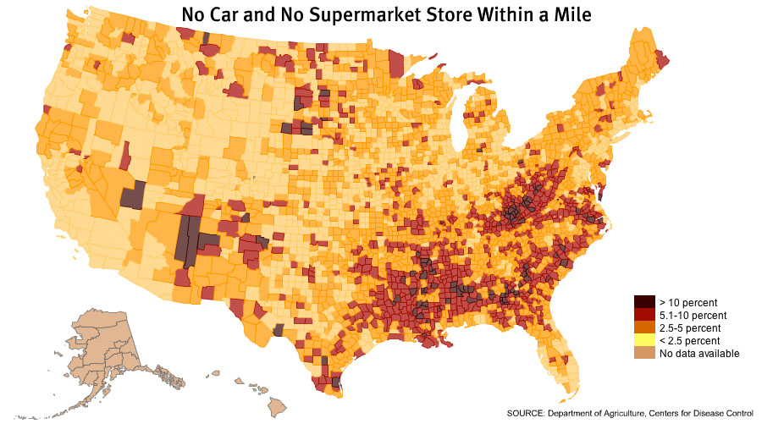
Food Deserts: An Introduction
According to the USDA, a food desert is a part of the country vapid of fresh fruit, vegetables, and other healthy options
Usually found in impoverished areas
At least 500 people and/or 33% of the census tract’s population lives more than one mile from a large supermarket
In Pittsburgh, food deserts are a very real problem
Until 2014, the Garfield neighborhood had not had a full service grocery store in 27 years
Source: Department of Agriculture, www.americannutritionassociation.org

Slide 3
The Problem
Beyond the problem of lacking fresh fruits, vegetables, and other healthy foods, food deserts tend to be plentiful with cheap alternatives
Processed, sugar, and fat laden foods
This adds to the nation’s rising obesity issues
As of 2017, adult obesity rates exceed 35% in 5 states, 30% in 25 states, and 25% in 46 states
Since the 1980s, childhood obesity rates (ages 2-19) have tripled
Additionally, food insecurity means access to healthy food, but also access to affordable food
There is conflicting reports about the link between obesity and low-income neighborhoods
But there is links between food deserts and obesity and links between food deserts and income

Slide 4
The Goal
Due to the conflicting information about obesity, low income neighborhoods, and food deserts, the goal of this project is to study the income disparities in Pittsburgh and correlations to food deserts and obesity by asking the questions:
How do food deserts relate to income and obesity?
Does income affect obesity rates?
Do farmers’ markets ameliorate food deserts?
It will be conducted by:
examining the history of Pittsburgh with hopes of explaining the income disparities
Creating ArcMap analyses of farmers markets and grocery stores, income, and obesity rates

Slide 5
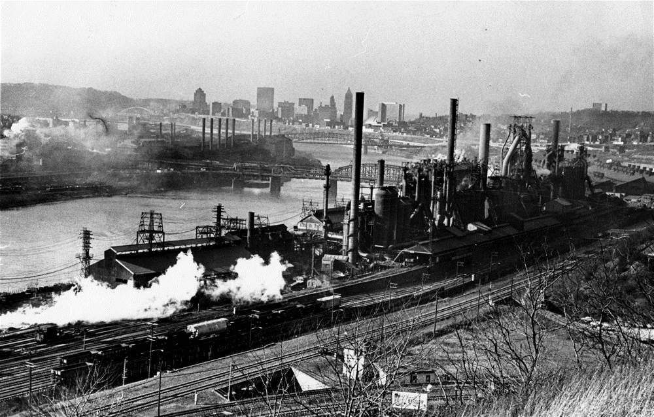
Pittsburgh’s History: Income Disparities
During the postwar prosperity of the 1950s and 1960s, more and more families could afford "suburban" living and moved out of the older neighborhoods to new suburbs accessible only by automobile
In the 1970s and 80s, the steel industry in Pittsburgh began to collapse—along with the deindustrialization of the rest of the United States
The steel mills began to shut down, approximately 153,000 workers were laid off, and the local economy suffered greatly
Those with money left, typically white people, fled to the suburbs
Young people also left, leaving a large gap in jobs and education
Pittsburgh’s Jones and Laughlin Steel Works, 1967
Source: brooklineconnection.com

Slide 6
Pittsburgh’s Present Day Income Disparity
James Huguley, a research associate at Pitts’ Center on Race and Social Problems in the School of Social Work, presented data on income disparity between black and white families
Mr. Huguley said nationally white families earn $1.67 for every dollar earned by black families, but locally the disparity is higher with white workers bringing home $1.89 for every dollar paid to black workers.
The average median household income of white households nationally between 2007-2011 was about 1.6 times that of black households
“In the Pittsburgh metropolitan area, white households took in twice as much as black households. The gap was even slightly wider than double within the city and Allegheny County” (Pitt report shows continued racial disparities in Pittsburgh, region)
Rebuilding the region's workforce has taken a full generation, but today Pittsburgh's workforce has one of the highest educational attainments in the nation and female labor force participation rates have caught up to what is typical across the nation
There is hope for the future to rebuild and equalize!

Slide 7
Food Deserts in Pittsburgh
Food Deserts are a problem in many places in Pittsburgh and according to a 2012 Department of Treasury report, among mid-sized cities, Pittsburgh has one of the highest percentages of people experiencing food insecurity
Approximately 47% of residents live in what are known as food deserts
A large reason for this may be technology based
Larry E. Davis, director of the Center on Race and Social Problems, said that while Pittsburgh’s economy may have done well in recent years in supplying high-tech jobs… African-Americans have been less prepared for such jobs than for those in the long-declining manufacturing sector.
Source: Pittsburgh Post-Gazette, explaining the struggle getting healthy food to low income families due to technology

Slide 8
The Project: Sources of Data
Often the first layer, Pittsburgh’s neighborhood boundaries were found on the GIS Online Database, entitled Pittsburgh Neighborhoods, from 2017
The GIS Online Database proved to be useful in also providing the “Income” and “Grocery” Data, found together, entitled Affordable_Housing Data, from CityPlanning in 2015
The population data came from the GIS Online Database, entitled Block_Group_Population_WFL1, from 2017
A choropleth map of population by block group by quantile
The “Farmer’s Market” Data is a shapefile downloaded from data.gov
This dataset, created in 2017, was harvested on a weekly basis from Allegheny County’s GIS data portal and Healthy Department data
The “Obesity” Data is a shapefile downloaded from the Western Pennsylvania Regional Data Center
Taken between 2006 and 2010, obesity rates for each Census Tract in Allegheny County were produced for a study between smoking and obesity. The rates were found using statistical modeling techniques.

Slide 9
Attribute Table: Farmers’ Markets

Slide 10
Attribute Table: Grocery

Slide 11
Attribute Table: Median Income

Slide 12
Attribute Table: Obesity Rates

Slide 13
Attribute Table: Population

Slide 14
Methods: Data Analysis and Manipulations Map 1
The purpose of Map 1 is to show the correlation between the median income per neighborhood and the amount of places to buy food— grocery stores and farmers’ markets
Without doing calculations, a simple visual allows the viewer to see the locations and make their own observations
Layer 1: Pittsburgh Neighborhood Boundary
Layer 2: Median Income
Layer 3: Farmers’ Markets
Layer 4: Grocery

Slide 15
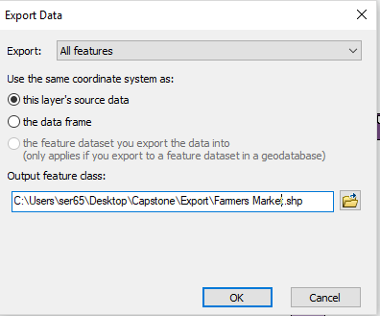
Methods: Map 1, Data Export
After importing the layers into ArcMap, the first step was to export the the farmers’ market and grocery data as a shapefile by right clicking on the layer > data > export data
After hitting okay on the image shown on the right, it uploads the new layer onto the map
Side note: I will use these exported shapefiles for the remainder of the maps (instead of the raw data)

Slide 16
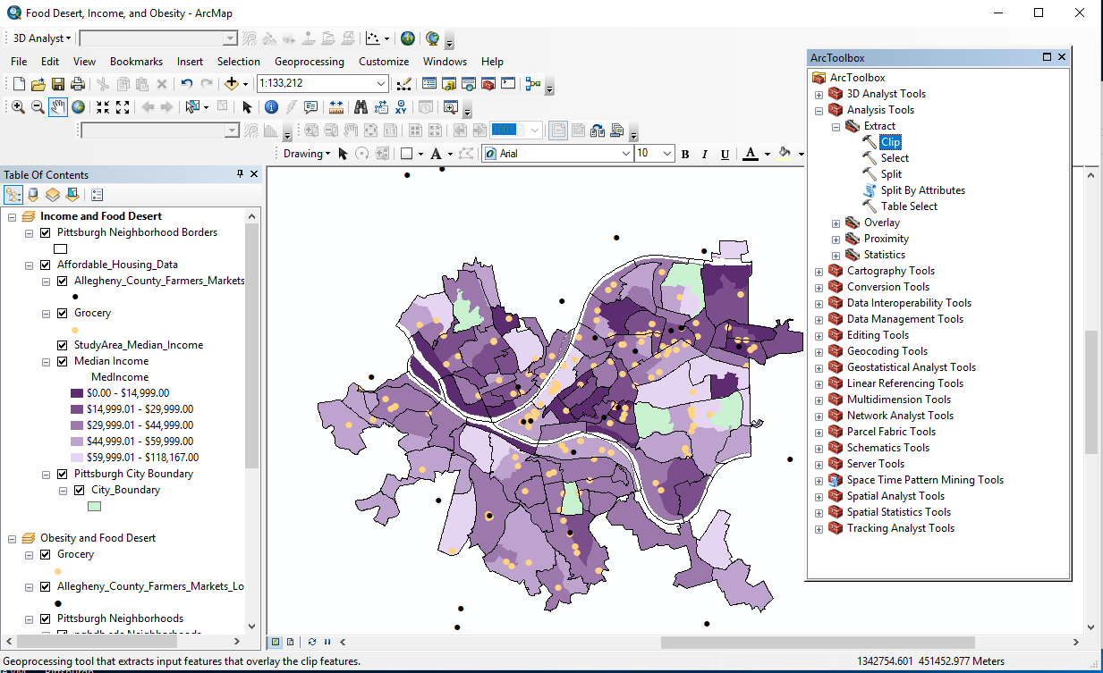
Methods: Map 1, Clip
The next step is to essentially “crop” the data so that all points lie within the city of Pittsburgh boundaries
There should not be any free floating points
This was done by using the clip tool
Arc toolbox > analysis tools > extract > clip

Slide 17
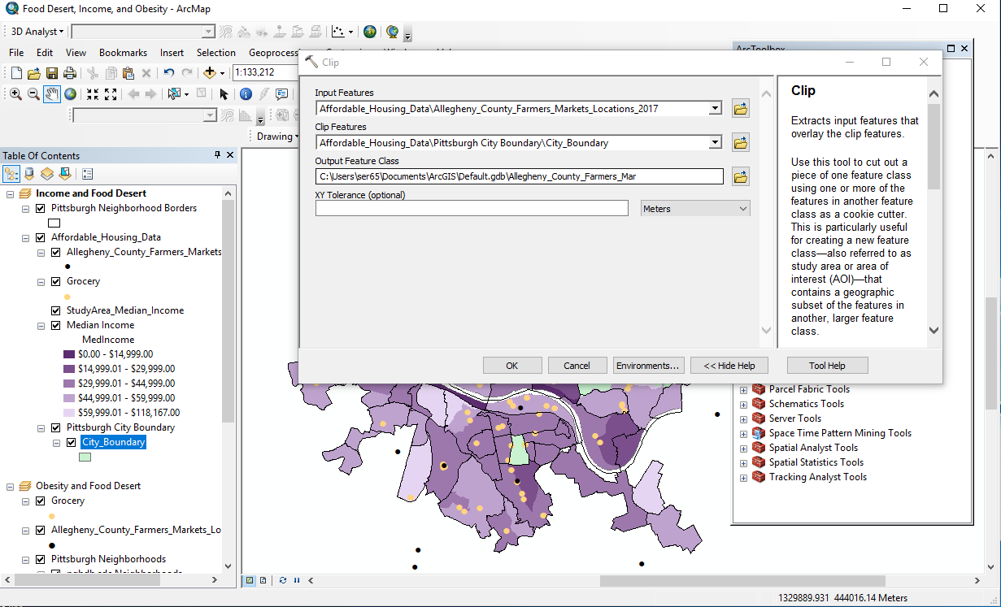
Methods: Map 1, Clip Continued
Because the grocery data was already limited to the city of Pittsburgh, I only had to clip the Farmers’ Market data
As mentioned prior, it is important to say I clipped the Farmers’ Market shapefile I created in step 1

Slide 18
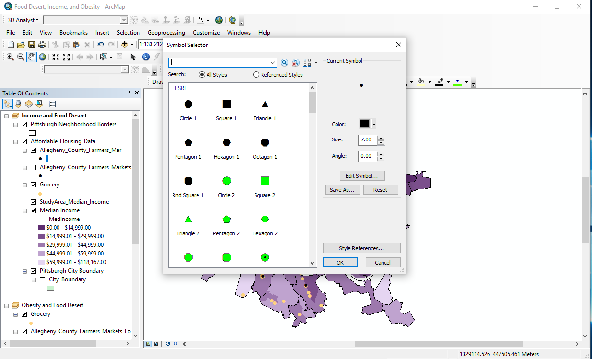
Methods: Map 1, Symbology
After clipping the data, the last step in creating Map 1 was to change the symbols in order to show the data clearly and accurately
Right click on the Farmers’ Market layer > Properties > Symbology > Symbol
I did this for both the Farmers’ Market and Grocery layers, adjusting the Farmers’ Market data to be a smaller size than the Grocery data for clarity purposes

Slide 19
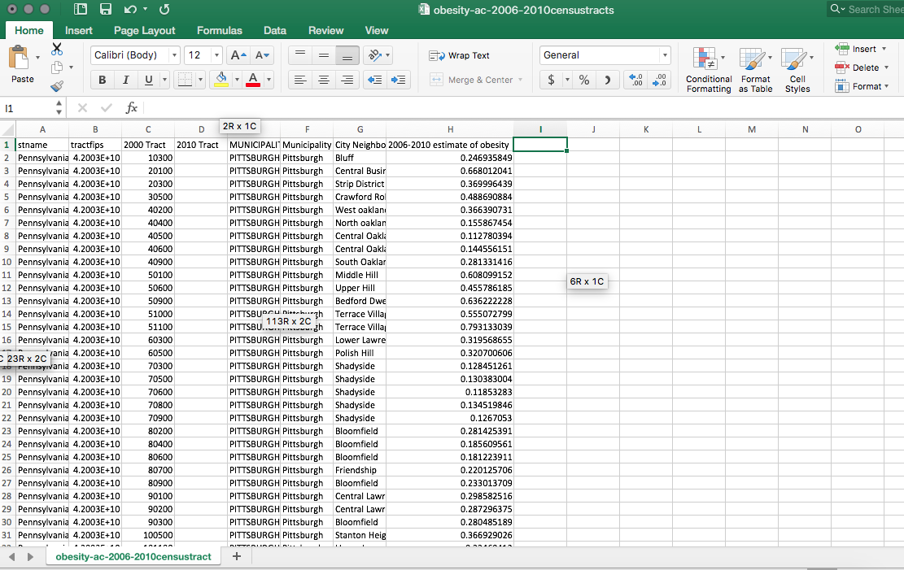
Methods: Data Analysis and Manipulations Map 2
This map shows the correlation between obesity rates per neighborhood and the places to buy food– farmers’ markets and grocery stores
In this study, the obesity rate average is estimated to be 0.26 and the highest rate is estimated to be 0.92
Layer 1: Pittsburgh Neighborhood Boundary
Layer 2: Obesity Rates
Layer 3: Farmers’ Markets
Layer 4: Grocery
The Excel data sheet provided by the Census Tract

Slide 20
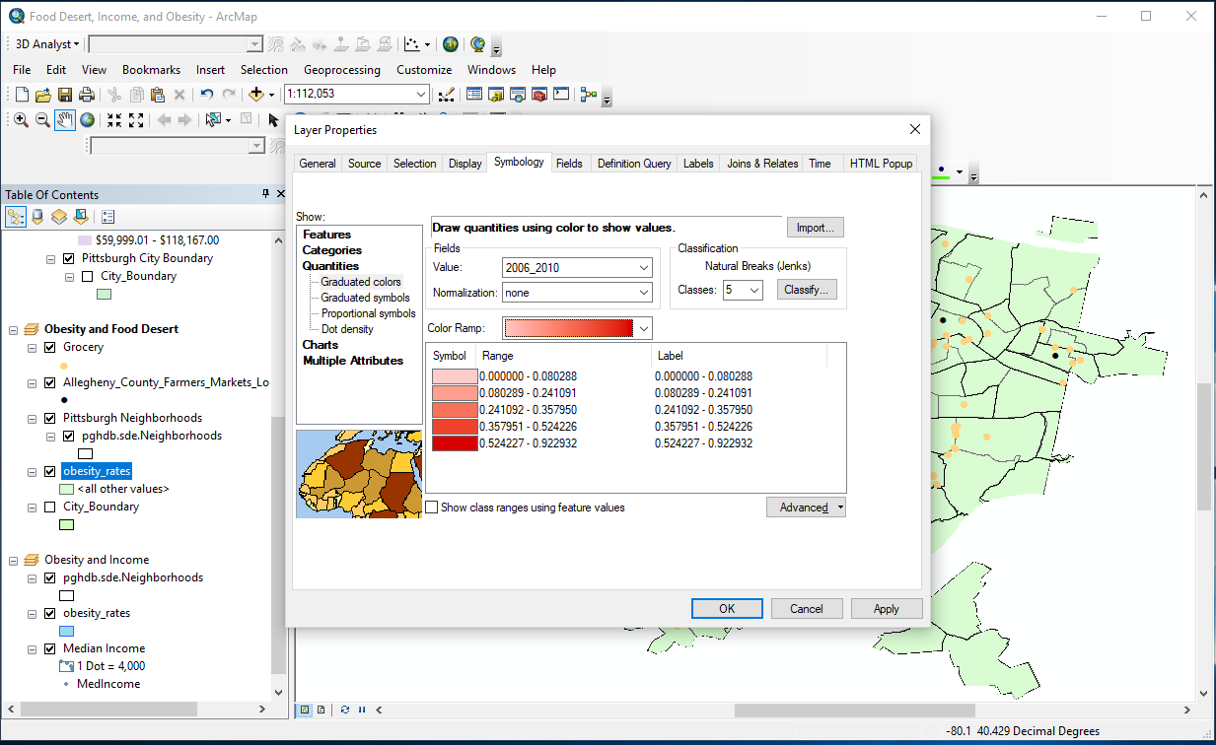
Methods: Map 2, Symbology
I used new data frame for each map, meaning I clicked insert > data frame
After importing the new data for Map 2 into the new data frame, I had to change the classes for obesity rates
The data came as one value and was not broken down by ranges
To change the symbology, right click on the obesity rates layer > properties > symbology > quantities > graduated colors
Under the Fields tab, my value was the rates, entitled “2006_2010”
Under the Classification tab, I chose 5 classes to break down the rates visually and chose a red color ramp

Slide 21
Methods: Data Analysis and Manipulations Map 3
The purpose of Map 3 was to create a map that attempted to find correlations between the median income and obesity rates
Layer 1: Pittsburgh Neighborhood Boundary
Layer 2: Obesity Rates
Layer 3: Median Income
Because both the median income and obesity were rates, a dot density analysis had to be conducted in order to show both on the same map

Slide 22
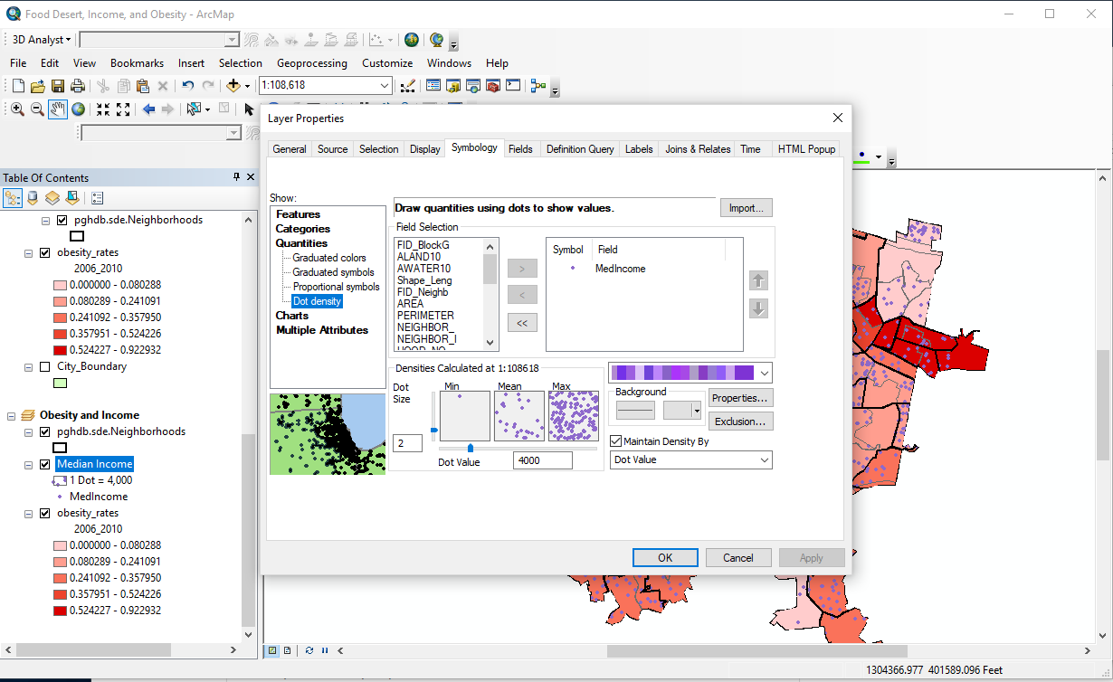
Methods: Map 3, Symbology and Dot Density
Per Map 2, I created a new data frame
Then, I created a dot density analysis by right clicking on the median income layer > properties > symbology > quantities > dot density
Under field selection, I clicked median income and chose a purple color ramp
I decided to stick with the suggest dot value of a size 2 dot, indicating a dot value of 4,000

Slide 23
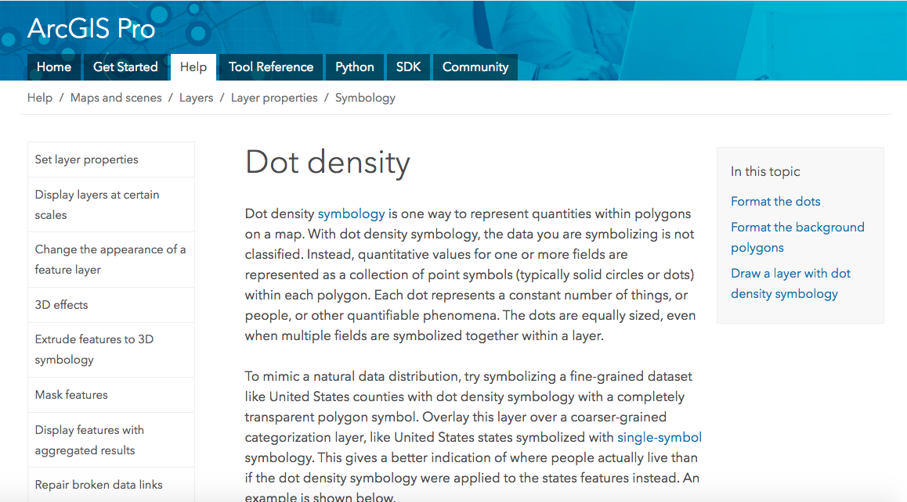
Methods: Map 3, Dot Density
In ArcMap, Dot Density is used to represent quantitative values for a field as a series of pattern fills based on the field value for each polygon
Each dot represents a specific value
In Map 3, each dot represents a median income of $4000
I found that this did not make the most sense and decided to try a new map, making Map 4
Source: ArcGIS Online

Slide 24
Methods: Data Analysis and Manipulations Map 4
Map 4 was created the same way Map 3 was and the layers stayed the same
I felt as though the correlation between obesity rates and income could be better shown if the Dot Density was conducted on obesity rates, rather than income
This meant I left the income rates as the main layer of the map and changed the dot density to obesity
I used the recommended dot value of 1 dot= 0.042126672

Slide 25
Methods: Data Analysis and Manipulations Map 5
The purpose of Map 5 was to examine hot spots and cold spots of food sources in the city of Pittsburgh
I attempted to do this by using the Hot Spot Anaylsis tool, however the results never quite worked and I often received “not significant” areas
I believe this to be due to a low number of data points that were assigned similar values
Instead, I conduced a a kernel density analysis in order to find highly dense areas of food sources, using both the grocery and farmers’ market data
Layer 1: Pittsburgh Neighborhood Boundaries
Layer 2: Grocery Density
Layer 3: Farmers’ Market Density
Layer 4: Grocery data points
Layer 5: Farmers’ Market data points

Slide 26
Methods: Map 5, Kernel Density
The Kernel Density tool calculates the density of features features in a neighborhood around those features
For point features, like the grocery and farmers’ market data, the density is calculated around each output raster cell
Source: ArcGIS Online

Slide 27
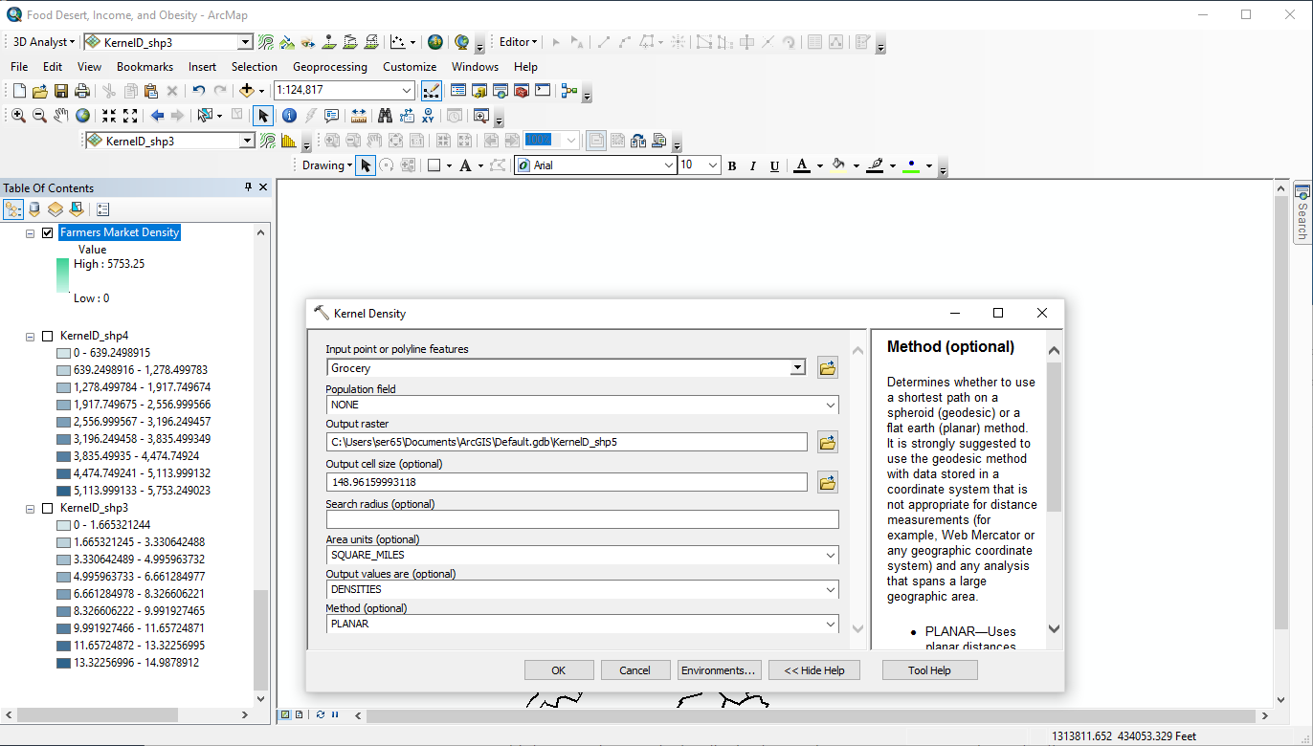
Methods: Map 5, Kernel Density Cont.
First, in the search bar, I searched for kernel density
I then filled in accordingly the inputs as grocery and famers market, left the population field as “none”, and left the area units as square miles
Because the kernel density came as 9 classes, I changed it to a color ramp on the symbology tab then clipped it using the Clip tool

Slide 28
Methods: Data Analysis and Manipulations, Map 6
The purpose of this map was to determine whether or not food deserts truly existed in Pittsburgh with calculations rather than visual assumptions
I chose to use the dot density, kernel analysis, and buffer tools to do this
Based on the definition of a food desert, I represented population using the same dot density tool explained previously, where one dot represents a value of 500
I kept the same kernel analysis from Map 5 in order to show high concentrations of food sources
Layer 1: Pittsburgh Neighborhood Boundaries
Layer 2: Grocery Density
Layer 3: Farmers’ Market Density
Layer 4: Pittsburgh Population
Layer 5: Grocery point data
Layer 6: Farmers’ Market point data
Layer 7: Grocery Buffer
Layer 8: Farmers’ Market Buffer

Slide 29
Methods: Map 6, Dot Density
The population data came as as blocked data, so it was changed to dot density the same way it was in previous steps

Slide 30
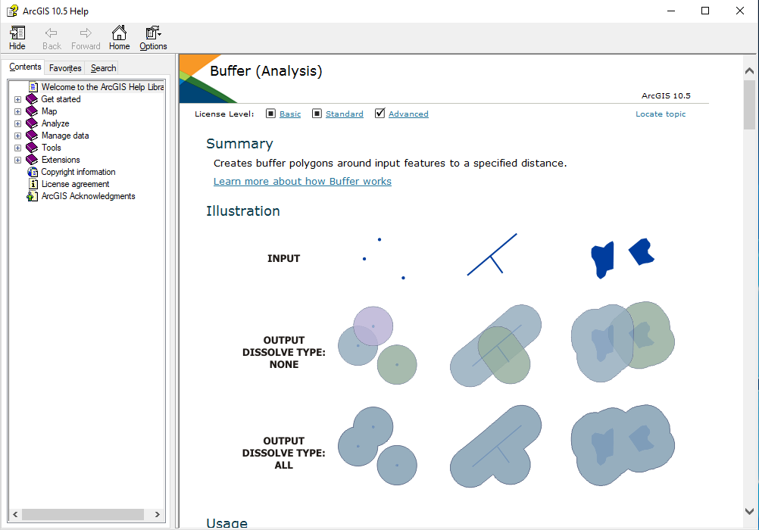
Methods: Map 6, Buffer Tool
The buffer routine traverses each of the input feature’s vertices and creates buffer offsets.
Output buffer features are created from those offsets
I used the planar method of parameter, which means that it automatically determines which method to use based on the input features
Because I specified a distance in meters, it chose a geodesic buffer
A geodesic buffer takes into account the shape of the earth
Source: ArcGIS Online

Slide 31
Methods: Map 6, Buffer Tool Cont.
After reading the literature entitled “Redefining the Food Desert” written by LeClair and Askan, I chose to use the buffer tool in order to show the mileage between the population and a food source
Grocery stores have a radius of 1/2 miles and Farmers’ Markets have a radius of 1/8 miles in order to recognize the more local influence of farmers’ markets
The less overlap in buffer circles, the more likely there it is to be a food desert

Slide 32
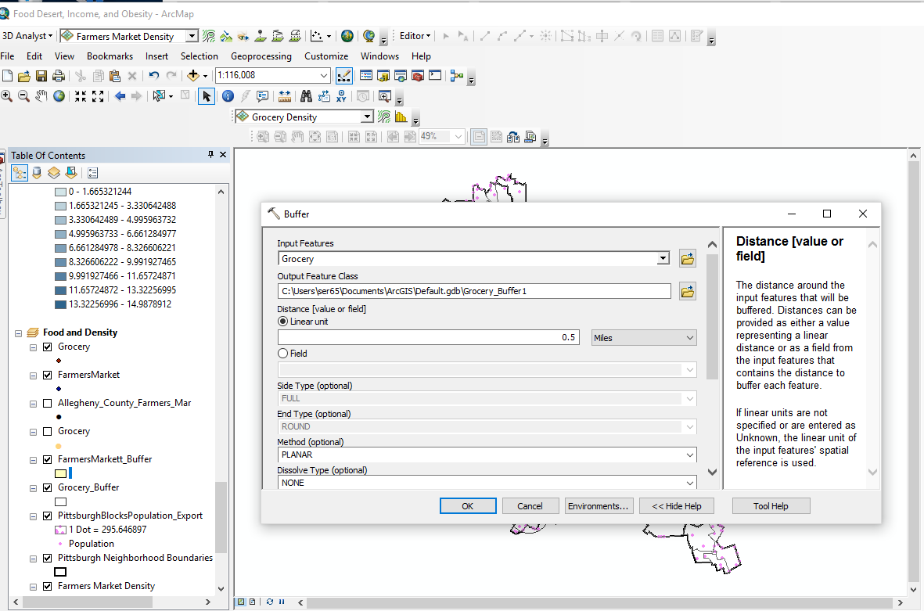
Methods: Map 6, Buffer Tool Cont.
The Buffer tool could be found by searching “Buffer” in the search bar
After that, I filled in the drop downs accordingly
The input features were Grocery and Farmers’ Market and I adjusted the linear unit
I changed the symbology of the data to be more clear
Grocery buffer circles are black and not filled in
Farmers’ Market buffer circles are filled in yellow

Slide 33
Methods: Data Analysis and Manipulations Map 7
The purpose of Map 7 was to show the radiuses around the food sources based around income, in order to find a correlation between lower income and food deserts again shown through the overlap in buffer circles
Layer 1: Pittsburgh Neighborhood Boundaries
Layer 2: Median Income
Layer 3: Grocery data point
Layer 4: Farmers’ Market data point
Layer 5: Grocery Buffer
Layer 6: Farmers’ Market Buffer

Slide 34
Final Images: Map 1 and Results
This map shows the food sources and the median income. By looking at the map visually like this, it appears as though there is no grocery and almost no farmers’ markets in the low income areas (the dark purple). There is a high concentration of grocery and farmers’ markets in the east end specifically, all in higher income areas.
As for the places with medium income and a surplus of food sources, I would hypothesize there is a connection to an ongoing gentrification crisis in some of these neighborhoods. The median income may not have risen yet, but the area is shaping towards an influx in income.

Slide 35
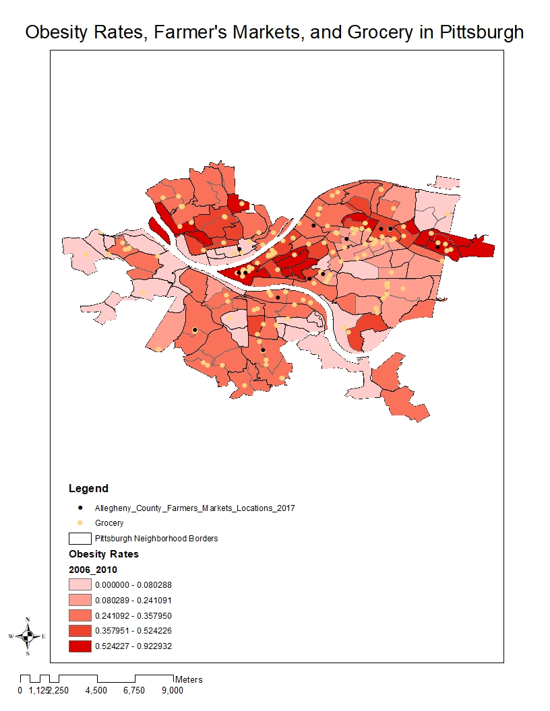
Final Images: Map 2 and Results
Map 2 actually backs up the conflicting results I found in my preliminary research. The obesity rates do not appear to have any visual correspondence to food availability.
The obesity rates are extremely high near downtown Pittsburgh but there are quite a few farmers’ markets and grocery stores. As you move further into the east end of Pittsburgh, there are quite a few areas of low obesity rates with farmers’ markets and grocery stores, but there are even more neighborhoods with extremely low obesity rates and no food sources.
I’m not sure why this is, so I created Map 4.

Slide 36
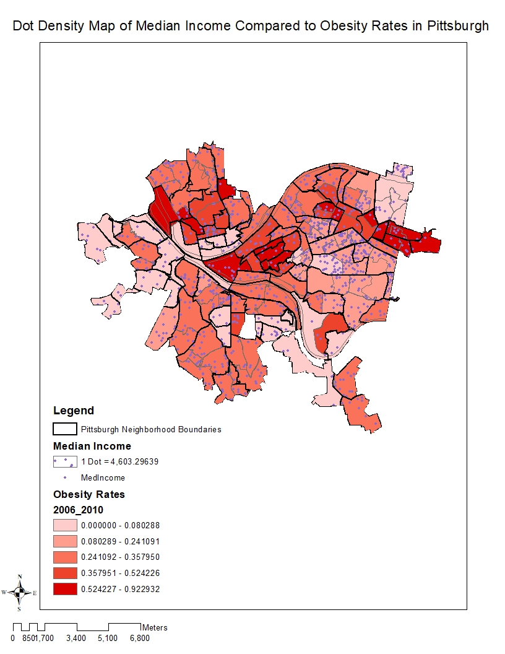
Final Images: Map 3 and Results
Map 4 shows the relationship between income and obesity. It appears as though, specifically in the Neighborhoods of Squirrel Hill and Shadyside in the East End that there is an extreme wealth, and relatively low obesity rates. However, the lowest obesity rates have very middle class class incomes.
Referencing Map 1, where income and food availability seemed to be linked, and this map, there should be some kind of correlation between obesity and food availability. This leads me to make Map 4, in order to visually show things more clearly.
Shown in Maps 2 and 3, there is no visually significant link between obesity and food availability, but there is a link between obesity and income and between income and food availability.

Slide 37
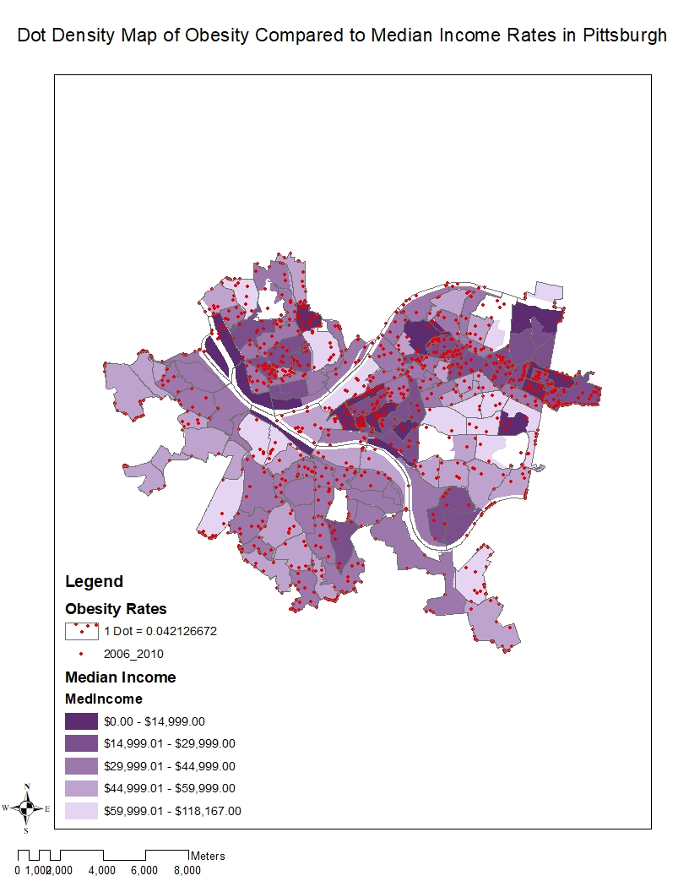
Final Images: Map 4 and Results
This map is considerably easier to read visually with the dot density done for obesity. Again, there is a correlation but it doesn’t visually appear to be a strong one. There is high concentrations of obesity rates in the extremely poor neighborhoods represented by a dark purple color.
There is a lower concentration of obesity rates in the middle class neighborhoods, which makes logical sense. However, in extremely poor neighborhoods there is little to no obesity rates.

Slide 38
Final Images: Map 5 and Results
Map 5 is the first image to beginning showing both visual and mathematical correlations. This shows the densities of food availability. The darker the area is, the more densely populated it is with farmers’ markets and grocery stores.
Per most maps, there is a heavy concentration in the East End, specifically in the wealthier neighborhoods like Shadyside and Squirrel Hill and in downtown.
There are few areas of highly concentrated food availability elsewhere.

Slide 39
Final Images: Map 6 and Results
Map 6 shows the finalized calculations of what constitutes a food desert. The larger, hollow, black circles show a ½ mile radius around grocery stores, based on the observations of the literature reviews I previously mentioned. The farmers’ markets’ have a radius 1/8 around each. There is a clear distinction between the East End and the rest of Pittsburgh in this map.
There is considerable overlap between buffer circles and therefore it would not be considered a food desert. There is almost no mileage in the East End that is not covered by buffer circles. However, the further away from downtown and the East End, the less the circles overlap and there is a clear lack of food availability, constituting a food desert. There is no overlap between farmers’ markets or between farmers’ markets and groceries. Therefore, it seems as though there is no correlation between food availability and farmers’ markets.

Slide 40
Final Images: Map 7 and Results
Map 7 is very similar to Map 6, however I wanted to show the relationship between food deserts and income because there was a previously clear visual correlation. In the wealthier areas, indicated by very light purple, there is always a substantial amount of food sources. However, there is a concentration in the East End that is not considered a food desert, but has quite a few poorer neighborhoods.
I believe the reason for this could be the gentrification that is occurring as was previously mentioned. Farmers’ markets can be a “trendy” addition to areas with a sudden influx of wealth, perhaps leading to this confusing correlation.
Otherwise and in general, most areas of wealth are not considered food deserts, where areas of poverty are.

Slide 41
Conclusions and Discussion
There is conflicting evidence about obesity rates and the correlation to food sources and income
The maps that I made seem to back up the literature I read
Obesity is not necessarily correlated to food availability, however it is correlated to low income neighborhoods (and low income neighborhoods tend to be more prone to food deserts)
Gentrification and malnourishment as possible answers to this conflict
When a neighborhood goes through the process of gentrification, as many places in Pittsburgh are currently, there is an in between stage where income, obesity, and food availability may not be accurately portrayed or takes into account the future
Malnourishment and malnutrition may be a possible answer to the extremely low obesity rates in the lowest income neighborhoods, because average rates of obesity occur in middle income neighborhoods
Overall, Pittsburgh can be considered to have pockets of food deserts
Based on my original research, I expected there to be food deserts in Pittsburgh and after making Map 1, I expected them to be in lower income areas, which proved to be true in Maps 6 and 7.
It does not appear as though famers’ markets ameliorate food deserts, due to their scarcity in the city
I cannot confidently say that farmers’ markets ameliorate food deserts in Pittsburgh. The maps showed that there was very little overlap, meaning that there was little access to them. It appears as though there extremely few farmers’ markets, however, for a size of a city like Pittsburgh so perhaps with the addition of more farmers’ markets, they could ameliorate food deserts. Another factor, is the seasonality of farmers’ markets and the effect of them in the fall and winter versus spring and summer.

Slide 42
Further Research: Food Pantries and Food Swamps
Food swamps are areas of with a high density of establishments selling high calorie junk foods relative to healthier food options
This could be a better way to look at obesity rates that could explain any discrepancy between obesity and food deserts—or lack thereof
Restaurants can contribute to food swamps, and food deserts, surprisingly making Oakland one of them. Oakland is highly dense in restaurants, which provide plenty of high calorie junk food, but is extremely scarce in grocery stores and even farmers’ markets.
I did not include the work of food pantries and food banks in this work, but they are important factors to consider, especially due to their prevalence in lower income neighborhoods
There are issues in implementing food banks and food pantries that can hault the accessibility of nutritional food availability, including technological limitations and government changes
An important thing to keep in mind is that even with these limitations, funding of food pantries in urban areas is much greater than in rural areas

Slide 43
References
Cooksey-Stowers, Kristen, Marlene B. Schwartz, and Kelly D. Brownell. “Food Swamps Predict Obesity Rates Better Than Food Deserts in the United States.” International Journal of Environmental Research and Public Health 14.11 (2017): 1366. PMC. Web.
“For Pittsburgh a Future Not Reliant on Steel Was Unthinkable ... and Unavoidable.” Pittsburgh Post-Gazette, www.post- gazette.com/businessnews/2012/12/23/For-Pittsburgh-a-future-not-reliant-on- steel- was-unthinkable-and-unavoidable/stories/201212230223.
McCart, Melissa, et al. “Pittsburgh Food Deserts.” Food Deserts | Pittsburgh Post-Gazette, newsinteractive.post-gazette.com/food-deserts/.
“Obesity Rates & Trends.” Obesity Rates & Trends - The State of Obesity, stateofobesity.org/rates/.
“Pitt Report Shows Continued Racial Disparities in Pittsburgh, Region.” Pittsburgh Post- Gazette, www.post-gazette.com/local/region/2015/01/13/University-of- Pittsburgh-report- shows-continued-racial-disparities-in-Pittsburgh/stories/201501130169.
“Pittsburgh Forum Examines Income Inequality and How to Address It.” Pittsburgh Post-Gazette, www.post-gazette.com/business/money/2014/11/18/Pittsburgh-forum-examines-income- inequality-and-how-to-address-it/stories/201411180017.
S. LeClair, Mark & Aksan, Anna-Maria. (2014). Redefining the food desert: combining GIS with direct observation to measure food access. Agriculture and Human Values. 31. 537-547. 10.1007/s10460-014-9501-y.
“USDA Defines Food Deserts.” American Nutrition Association, americannutritionassociation.org/newsletter/usda-defines-food-deserts.

