Slide 1
MSAFI Hand-washing Health Message
Aniah Mcleod and Clare Miller

Slide 2
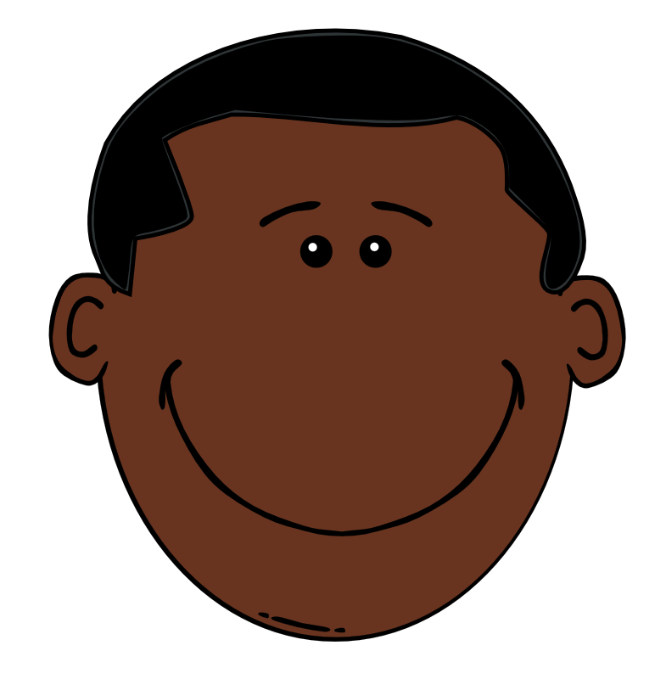
Kuwa Kama Msafi!
Msafi daima huosha mikono kabla ya kula chakula!
Msafi ni mtu mwenye afya, yeye hana magonjwa.
Osha mikono yako kila wakati kabla ya kula,
Hivyo wewe utakuwa mtu mwenye afya pia!

Slide 3
Kiswahili-KiIngereza translation
Msafi washes his hands before eating food!
Msafi is a healthy person, he has no sickness.
Wash your hands every time before eating,
So you will be a healthy person too!

Slide 4
Potential Funder: US AID WASH (WATER, SANITATION, AND HYGEINE)
2013-2018 WATER DEVELOPMENT STRATEGY HAS 3 GOALS; OUR POSTER FITS WITH THEIR SECOND GOAL OF “SUPPORTING ADOPTION OF IMPROVED HYGEINE BEHAVIORS”
TANZANIA WSP (WATER AND SANITATION PROJECT)
TANZANIA WSP HAS A PUBLIC-PRIVATE PARTNERSHIP FOR HANDWASHING WITH SOAP. (estabished in 2005). UTILIZES MULTIPLE MEDIA OUTLETS SUCH AS COMIC STRIPS, FLYERS, EDUCATIONAL PROGRAMS, A RADIO SPOT, AND A SOAP OPERA
THE SOAP OPERA FOLLOWED ONE CHARACTER, MR. MTAFUNGWA, TO ENCOURAGE HAND WASHING. OUR HEALTH MESSAGE ALSO FOLLOWS A CHILD CHARACTER, MSAFI, WHO IS LEARNING TO WASH HIS HANDS WITH HIS FAMILY BEFORE MEALS

Slide 5
poor sanitation
Hepatitis A
Trachoma
Schistosomiasis
Intestinal parasites (Ex. Hook worm)
*Diarrheal Diseases- Cholera, rotavirus, E. Coli, and more
*Acute Respiratory Infections- Pneumonia

Slide 6
TARGETED DISEASES
Pneumonia (15%) and Diarrhea (9%) are the TOP 2 KILLERS of young children around the world
Pneumonia (Acute respiratory system infection)
Caused by bacteria, viruses and fungi
Kills 2,500 children under 5 per day worldwide (UNICEF)
Can be treated with antibiotics
Can be prevented by clean environment and vaccination
Diarrheal Disease
Caused by unsanitary living conditions, contaminated water sources, and malnutrition
Kills 1,400 children under 5 per day worldwide (UNICEF)
Can be treated with oral rehydration therapy and zinc supplementation
Can be prevented by hand washing, improved water sources and sanitation, rotavirus vaccinaiton
TANZANIA
15-19% of deaths in children under 5 are attributable to pneumonia (WHO 2015)
5-9% of death in children under 5 are attributed to diarrheal diseases (WHO 2015)

Slide 7
What can BE DONE?
Treatment in Tanzania
55% of under-5 children with suspected pneumonia are taken to health provider
45% of under-5 children with diarrhea are receiving oral rehydration salts
Disease Prevention Methods:
WASH (Safe water, Adequate Sanitation, and Hygiene)
Clean environment
Efficiency of Prevention
Sanitation education and access to soap in schools improve attendance (CDC)
Washing hands with soap and water could reduce diarrheal disease-associated deaths by up to 50% (WHO)

Slide 8
Our Approach: We created a character named msafi
Msafi
Kiswahili-English translation: Msafi means a clean person
Adolescent boy, age ~11
Eats every meal with his parents/grandparents and little sister
Targeting a Behavior
We are using Msafi to show children how to practice proper hygiene and sanitation
Arrows outline the 3-step sequence of events necessary for proper hand sanitation

Slide 9
Additional thoughts
We originally had Msafi as a superhero in order to appeal to authority to children BUT…
Our Tanzanian friends did not know what superheroes were
Their heroes as children were their family members, not book characters
Question: Mtu ambaye ni musuko wako? (Who is the person that inspires you?)
Female Response: Shangazi na dada (Aunt and sister)
Male Response: Baba na Momma (Father and mother)
We changed the direction of our health message to target behavior change within the entire family
Notes:
When we asked our Tanzanian friends if they admired any superheroes as children, they didn’t know what superheroes were.
with nice and clean blue hands.
Target entire family instead of only one member

Slide 10
Context: Use of color association
RED
Msafi has red hands before he washes his hands with soap and water
Msafi also has red hands before he comes in to contact with his food
The color red discourages behavior of not washing your hands before eating
BLUE
Color of the bar soap and color of the water
Msafi has blue hands after he washes his hands with soap and water
Msafi, his sister and his parents/ grandparents all have blue hands while eating their food
The color blue encourages hand washing with soap and water

Slide 11
Appeals
Appeal to Similarity
Family ties and close relations, ‘Be like Msafi’, use of a common Tanzanian hand washing practice, eating meals while sitting on a mat, momma/ grandmother wearing a kanga
Appeal to Emotion
Happiness associated with hand washing
Red hands linked to a bad behavior
Appeal to Authority
Presence of two adult figures- Mother and father or grandmother and grandfather
Young girl is looking up to her big brother as he washes his hands

Slide 12
Call to Action
Call to Action- Wash your hands before you eat
Is it Actionable? Yes.
Target Audience: Children (‘Be like Msafi’)
We hope that children will relay this message to their family and encourage hand washing before meals

