Slide 1
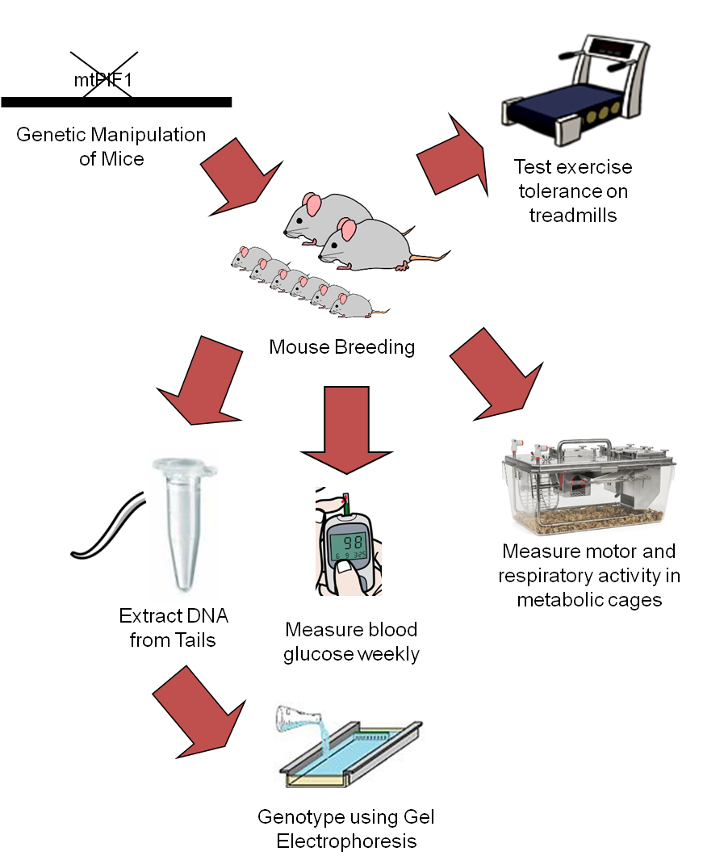
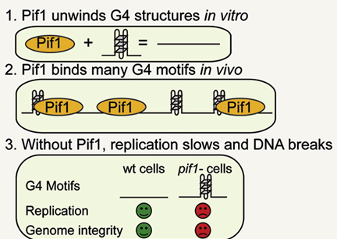
Investigating the effect of mtPIF1 removal
on exercise intolerance and weight gain in mice
Amal Saeed, Abhik Mukherji and Nikita Desai Faculty Mentor: Brett A. Kaufman, University of Pittsburgh School of Medicine, Vascular Medicine Institute
Background
Results
Metabolic diseases have become top public health concerns worldwide, with 78.6 million and 29.1 million people suffering from obesity and diabetes respectively in the U.S. alone (Adult Obesity Facts, 2015; Statistics about Diabetes, 2016).
These diseases lead to more severe illnesses such as coronary artery disease, stroke, and nerve, kidney, and/or eye damage (Diabetes Complications, 2014).
Metabolic activity occurs primarily at cells’ mitochondria, which have their own DNA independent of nuclear DNA.
PIF1 is a gene which translates a protein PIF1 helicase which unwinds G-quadruplexes in DNA, irregular structures that inhibit DNA from being translated to proteins.
This is expressed in the nucleus and the mitochondria
Methods
Figure 3. Genotyping Agarose Gel Example
Figure 2. Methods Flow Diagram
This figure shows an example of an agarose gel used to genotype mice. Gel electrophoresis was performed on DNA isolated from mouse tails, and the bands from these samples were compared to a negative control marked NTC, 842, a positive PIF1 knockout control, and 844, a heterozygous PIF1 knockout control. Mouse genotype was determined by matching DNA bands to these controls, and wild type mice did not match 842 or 844. Mouse 22 and 38 in this example are heterozygous, 39 is a PIF1 knockout, and 29 is a wild type.
Objectives
To learn how removing PIF1 affects mitochondrial DNA (mtDNA) stability
To learn if removing PIF1 affects the phenotypes of mice (e.g. development of obesity, diabetes, etc.)
To learn about mtDNA instability’s contribution to metabolic disease as a whole
Conclusion
No true conclusions can be drawn from this research yet
Mice with PIF1 removed and wild type (without PIF1 removed) mice have been successfully bred BUT they need to grow for about 6 months in order for any conclusions to be drawn about the effect of PIF1 removal on phenotype
Future: Data will be continue to be collected on the mice for 6 months. Afterwards, conclusions can be drawn on PIF1’s impact on exercise tolerance and/or metabolic illness through regulation of mtDNA stability.
Figure 1. PIF1 Function Diagram
References
Adult obesity facts. (2015, September 21). Retrieved from http://www.cdc.gov/obesity/
data/adult.html
Diabetes complications. (2014, July 31). Retrieved from http://www.mayoclinic.org/ diseases-conditions/diabetes/basics/complications/con-20033091
Paeschke, K., et al. (2011). "DNA replication through G-quadruplex motifs is promoted by the Saccharomyces cerevisiae Pif1 DNA helicase." Cell 145(5): 678-691.
Statistics about diabetes. (2016, April 1). Retrieved from http://www.diabetes.org/ diabetes-basics/statistics/
Acknowledgements
This figure shows PIF1’s function in unwinding G-quadruplexes to maintain DNA stability. This ensures that DNA is properly replicated and eventually used to make PIF1 helicase (Paeschke et al., 2011).
We would like to thank our mentors in the Kaufman lab, Frances Belmonte, Ph.D., and James Martin, for guiding us and helping us learn about lab protocols and the research as a whole. This is primarily Frances’ project; we simply helped her in her research.

